Slide 1
Micro Credit Defaulter Prediction

Slide 2
Introduction to Micro Finance Schemes
Useful when targeting especially the unbanked poor families living in remote areas with not much sources of income.
Mobile Financial Services are more convenient and efficient, and cost saving, than the traditional high-touch model.
Microfinance is widely accepted as a poverty-reduction tool, representing $70 billion in outstanding loans and a global outreach of 200 million clients.

Slide 3
Objective
Telecom industry is collaborating with an MFI to provide micro-credit on mobile balances to be paid back in 5 days.
Build a model which can be used to predict in terms of a probability for each loan transaction. For the loan amount of 5 (in Indonesian Rupiah), payback amount should be 6 (in Indonesian Rupiah)
For the loan amount of 10 (in Indonesian Rupiah), the payback amount should be 12 (in Indonesian Rupiah).
The Consumer is believed to be defaulter if he deviates from the path of paying back the loaned amount within the time duration of 5 days.

Slide 4
Data Info
1
Let’s start with Data Pre-processing

Slide 5
209593 Entries
36 Feature
21 Float Datatype,13 Integer Datatype & 3 Object Datatype
All are non-null values

Slide 6
Data Visualization – Univariate Analysis
2
Let’s start with our visualization on the dataset using Univariate Analysis Techniques

Slide 7
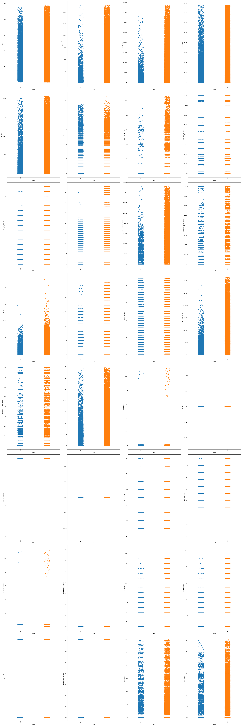
Analysis on Scatter Plot
Age on Network >1800 days - The customers are more likely to repay.
Average of daily amount spent from main account over last 30 days > 5000 Indonesian Rupiah - The probability of repayment increases.
Average of daily amount spent from main account over last 30 days > 5000 Indonesian Rupiah - The probability of repayment increases.
Average main account balance over last 30 days > 8000 Indonesian Rupiah. There are less number of defaulters.

Slide 8
Analysis on Scatter Plot
Average main account balance over last 90 days is more than 10000 Indonesian Rupiah - Less defaulters
Number of days till last recharge of main account > 9 - Frequency of loan is less but, they repay the loan for sure without being a defaulter.
Number of days until last recharge their data account < 4 days - Very high probability of repaying the loan.

Slide 9
Analysis on Scatter Plot
Number of time main account got recharged in the last 30 days >12 – More likely to repay.
Frequency of main account recharge in the last 30 days > 30 - Very high chance of repayment.
Total amount of recharge in main account over last 30 days > 13000 Indonesian Rupiah – Less chances of being a defaulter.

Slide 10
Analysis on Scatter Plot
Median of main account balance just before recharge in last 30 days at user level > 35 Indonesian Rupiah – Significantly high repayment probability.
Number of recharges in the main account in the last 90 days > 20 - The repayment probability.
Total amount of recharge in main account over last 90 days > 20000 Indonesian Rupiah - Less chances of defaulter.

Slide 11
Analysis on Scatter Plot
Median of main account balance just before recharge in last 90 days at user level > 20 Indonesian Rupiah – High repayment probability.
Number of recharge in data account in last 30 days > 68 times - Less likely to become defaulter.
Maximum amount of loan taken by the user in last 30 days > 68 - Higher tendency to repay.

Slide 12
Analysis on Scatter Plot
Number of loans taken by user in last 90 days >10 – Less chances of being a defaulter.
Total amount of loans taken by user in last 90 days > 60 - Less chances of being a defaulter.
Higher the average payback time in days over last 30 days or over last 90 days higher are the chances of repayment.

Slide 13
Feature Selection
3
Identification of highly corelated features using HeatMap and Select K Best Technique

Slide 14
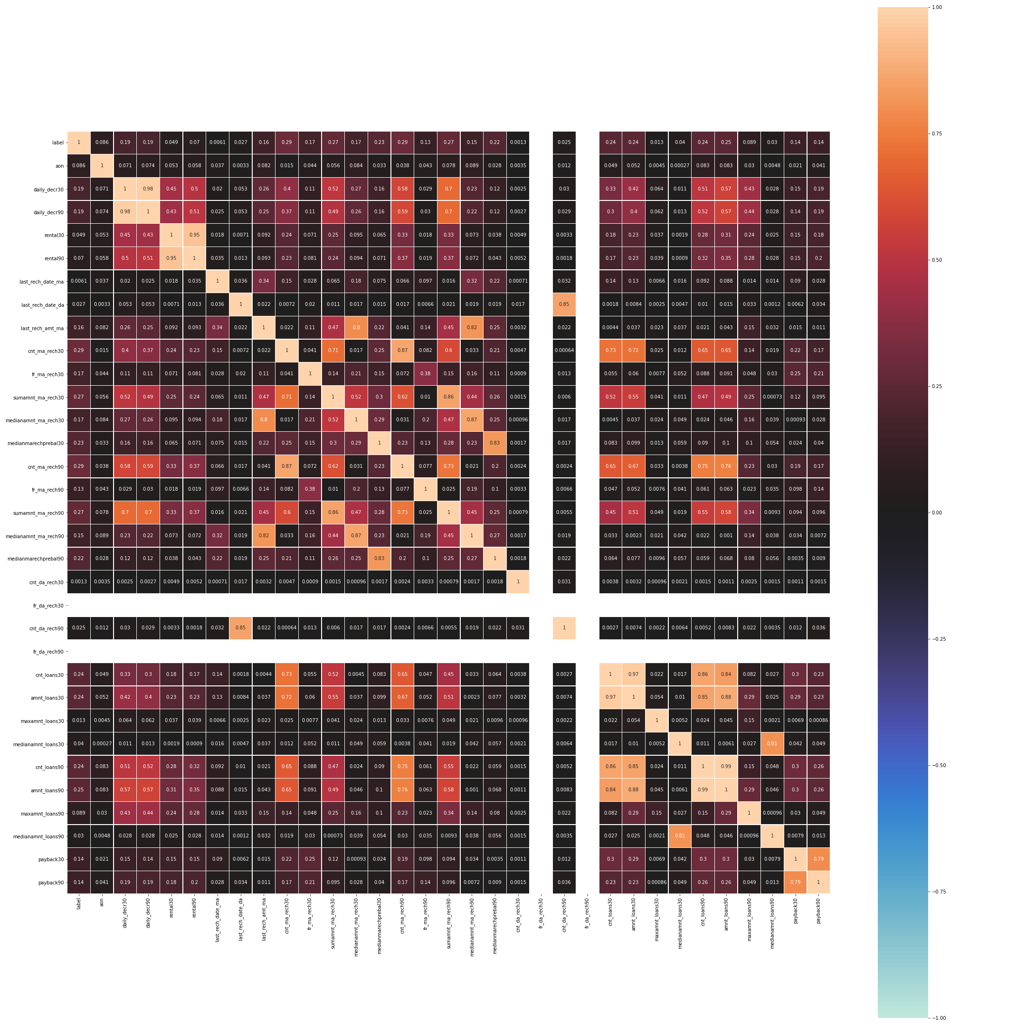
Analysis on Heat Map
The following features are highly correlated hence they are dropped from the dataset for improved accuracy of prediction.
'daily_decr30', 'rental30'
cnt_ma_rech30‘
'last_rech_date_da‘
'sumamnt_ma_rech30‘
'medianamnt_ma_rech30‘
'medianamnt_ma_rech90‘
'medianmarechprebal30‘
'cnt_loans30‘
'cnt_loans90‘
'maxamnt_loans30‘
'medianamnt_loans30‘
'maxamnt_loans90‘
'medianamnt_loans90'

Slide 15
Select K Best Feature Using the Select K Best Technique the final 12 features which have been selected for model fitting are
cnt_ma_rech90
sumamnt_ma_rech90
amnt_loans90
amnt_loans30
Medianmarechprebal90
daily_decr90
fr_ma_rech30
last_rech_amt_ma
Payback30
Payback90
fr_ma_rech90
aon

Slide 16
Model Fitting and Tuning
4

Slide 17
Accuracy and Precision of Models
Model Name | Accuracy | Precision | F1 Score | Accuracy after Tuning | Precision after Tuning | F1 Score after Tuning
Logistic Regression | 0.86 | 0.43 | 0.46 | - | - | -
KNN | 0.88 | 0.76 | 0.71 | 0.89 | 0.79 | 0.71
Decision Tree | 0.85 | 0.69 | 0.69 | 0.90 | 0.73 | 0.77
Random Forest | - |  |  | 0.90 | 0.85 | 0.73
XG Boost | - |  |  | 0.83 | 0.85 | 0.77

Slide 18
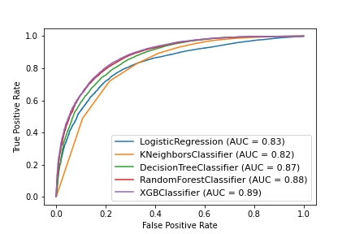
ROC Curve and AUC
The area under curve for XGBoost is maximum. Hence, it is selected as the final model for prediction of Micro Credit Defaulter.

Slide 19
Conclusion

Slide 20
Based on our analysis the XG Boost Classifier predicted the Micro Credit Defaulter.
Accuracy – 0.90
Precision (Defaulter) – 0.77
Overall Precision – 0.84
Hyper Parameters – {max_depth=10, learning_rate=0.01, n_estimators=1000, colsample_bytree=0.7, scoring='neg_mean_squared_error', verbose=1}
AUC – 0.89

